Slide 1
A guide for preventing workplace bullying
For All Employees

Slide 2
Workplace Bullying
Workplace bullying is a risk to health and safety.
Like all health and safety risks it is best dealt with by taking steps to prevent it from occurring and responding quickly if it does occur.
This guide provides information on what you as an Employee can do to prevent bullying from occurring and what to do if you witness or experience bullying in the workplace.
Definitions:
Bullying is defined as repeated and unreasonable behaviour directed towards a worker or a group of workers that creates a risk to health and safety.
Repeated behaviour refers to the persistent nature of the behaviour and can involve a range of behaviours over time.
Unreasonable behaviour means behaviour that a reasonable person, having regard for the circumstances, would see as unreasonable, including behaviour that is victimising, humiliating, intimidating or threatening.

Slide 3
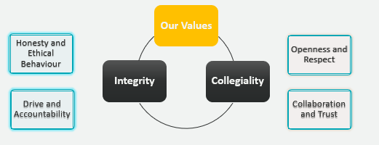
Preventing Workplace Bullying
Workplace bullying is best dealt with by taking steps to prevent it before it creates a risk to health and safety.
Values | Respectful Relationships
Actively commit to and demonstrate the SCU values of collegiality and integrity in your day-to-day activities. | Treat all others with respect, courtesy, fairness and equity at all times. Ensure your behaviour at work is respectful of others and of a professional nature. Be authentic in your actions and words. Be self aware of your own behaviours and the impact of your behaviours on others. Actively promote safe working practices and safe working environments for everyone. Respect SCU policies and procedures in relation to Harassment, Bullying and Discrimination.

Slide 4
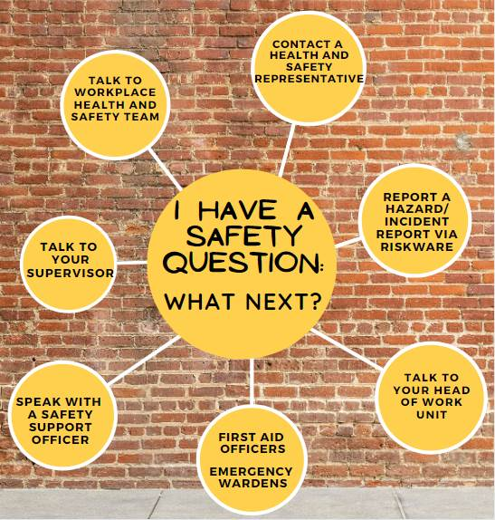
What to do if you witness or experience bullying
Ask them to stop
If you feel safe and comfortable doing this, calmly tell the other person that their behaviour is unreasonable and ask them to stop it. They may not realise the effect their behaviour is having on your or others, and your feedback may give them the opportunity to change their actions.
Have the confidence to seek advice
As a staff member at the University, it is your responsibility to say something if you see or experience something. There are many ways that you can advise us: Report a hazard/incident report via RiskWare Talk to the Workplace Health and Safety team Talk to your supervisor Talk to your Head of Work Unit Contact a Health and Safety Representative Speak with a Safety Support Officer
Check the relevant SCU Policies and Procedures
Read the SCU policies and procedures you can follow: Harassment, Bullying and Discrimination Prevention Policy Complaint Policy Complaint Procedure

Slide 5
SCU Policies:
Harassment, Bullying and Discrimination Prevention Policy
Complaint Policy
Complaint Procedure
Additional Resources:
SafeWork Australia Guide to Preventing and Responding to Workplace Bullying
Support:
Human Resources:
Email: hr@scu.edu.au
Phone: 02 6620 3667
Assure Programs:
Employee Assistance Program
Phone: 1800 808 374

